Slide 1
Indonesia Healthcare Infrastructure Analysis
Personal Project by Rangga Hadiwibowo

Slide 2


About Datasets
Hospital Data
Original Title: Hospital Data in Indonesia
Last Update: February 1, 2025
Rows: 3091
Columns: 12
Population Data
Original Title: Population, Population Growth Rate, Percentage Distribution of Population, Population Density, and Population Sex Ratio by Province, 2026
Last Update: February 6, 2026
Rows: 43
Columns: 6

Slide 3





Project Workflow
01
02
03
Problem Statement
Data Understanding
Data Preparation
04
Data Visualization
Excel
Python
SQL
05
Power BI
Evaluation & Reporting
PowerPoint

Slide 4
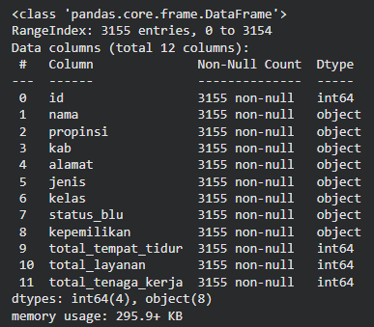
01
Data Understanding
General Overview of the Datasets
Inspect the structure of each dataset to identify column names, data types, and missing values. Based on this information, determine which columns will be used in the following steps. Column names and their order are also adjusted to improve readability.
Findings
All column in the hospitals dataset has no Null values.
All column in the population dataset has Null values.
All column in the hospitals dataset will be used for future steps.
Only several column in the population dataset will be used:
'province'
'population_thousand'
'population_density'

Slide 5
02
Data Understanding
Detect Duplicate Values in Key Columns
The primary key in each dataset acts as the unique identifier for every row. This step checks whether duplicate values exist in the primary key fields.
Findings
Key in both datasets has no duplicate values.
03
Detect Zero or Negative Numbers in Specific Columns
After reviewing the column descriptions, numerical values are inspected. The 'total_beds' , 'total_labors', and 'total_services' columns should not contain zero or negative values, so this step identifies any invalid records.
Findings
There are zero or negative numbers in 'total_beds' and 'total_labors', while 'total_services' does not have it.

Slide 6
04
Data Understanding
Detect Outlier Anomalies with Z-Score Method
Besides invalid values, large datasets may also contain outliers. This step uses the Z-score method to identify extreme values, while domain knowledge is used to determine whether the detected values should be treated as anomalies.
Findings
There are 2 value considered as anomalies in 'total_beds', while 'total_services' and 'total_labors' does not have it.
05
Compare Shared Column between Datasets
The shared column is used as the join key between both datasets, so its values must be consistent. This step identifies any differences in the shared column before joining.
Findings
From all of item in shared column of Province, only "Yogyakarta" has different value, which has "DI Yogyakarta" in the other dataset.

Slide 7
01
Data Preparation
indonesia_hospitals.csv
indonesia_population_2026.csv
Data Cleaning and Formatting
hospital_population_cleaned.csv
province_summary.xslx
02
Prepare Key Indicator using Business Questions

Slide 8
01
Data Preparation
Data Cleaning and Formatting
Perform data cleaning based on the findings from the Data Understanding phase. In addition, reformat the datasets to improve consistency and simplify further analysis.
Handling null values
Handling zero or negative numbers
Handling outlier anomalies
Standardize Province Names
Merge datasets

Slide 9
02
Data Preparation
Prepare Key Indicator using Business Questions
How many hospitals are there in each province?
How many beds are there in each province?
Measures the distribution of healthcare facilities and identifies provinces with higher or lower hospital availability.
Indicates the healthcare system's capacity to accommodate patients in each province.
What is the number of bed per 1K population in each province?
How many class A and B hospitals are there in each province?
Evaluates whether hospital bed capacity is sufficient relative to the size of the population.
Shows the distribution of high-tier referral hospitals capable of providing specialized and complex medical services.

Slide 10
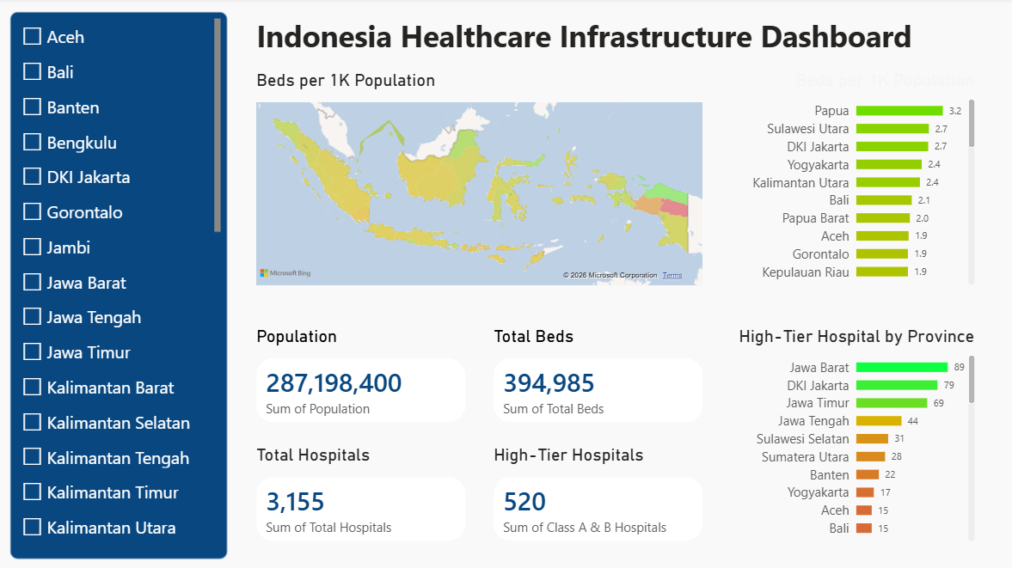
Data Visualization
The cleaned and aggregated dataset was imported into Power BI to create an interactive dashboard. The dashboard enables users to quickly identify regional disparities in hospital availability, healthcare capacity, and access to advanced healthcare services.

Slide 11
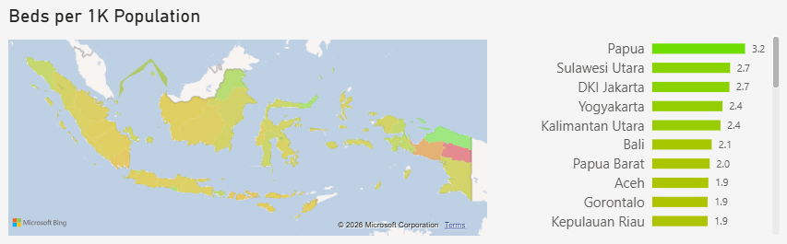
Hospital Distribution Analysis
Data Evaluation
The World Health Organization (WHO) uses hospital beds per population as an international health system indicator to assess healthcare capacity. In this analysis, the metric is used to compare the availability of inpatient healthcare resources across Indonesian provinces and identify regional disparities.
<1 | Low bed availability; limited inpatient capacity. Common in many lower-resource health systems.
1-3 | Moderate bed availability. Many developing and middle-income countries fall within this range.
3-8 | Typical range for many developed countries.
>10 | Very high bed availability, seen in countries such as Japan and South Korea.
Indonesia beds per 1K population index ranging from 0.3 to 3.2, with average of 1-2 in most of provinces. The top 5 highest beds per 1K population is Papua, Sulawesi Utara, DKI Jakarta, Yogyakarta, and Kalimantan Utara, with Papua is the only province within group of many developed countries had.

Slide 12
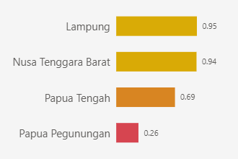
Hospital Distribution Analysis
Data Evaluation
Province | Population | Total Beds
Lampung | 9.623.800 | 9.116
NTB | 5.815.300 | 5.482
Papua Tengah | 1.510.800 | 1.042
Papua Pegunungan | 1.501.900 | 392
Even though most of the province across Indonesia has above WHO recommendation of beds per 1K beds index, there are 4 province that is still considered low in beds, that is Lampung, Nusa Tenggara Barat, Papua Tengah and Papua Pegunungan.

Slide 13
High-Tier Hospital Distribution
Data Evaluation
Class | Typical Services
Class A | Comprehensive specialist & subspecialist services, advanced diagnostics, complex surgery, ICU, cancer treatment, organ transplant support, etc.
Class B | Specialist and several subspecialist services, advanced surgery, intensive care, emergency referral.
Class C | Basic specialist services (internal medicine, surgery, pediatrics, obstetrics & gynecology).
Class D | General medical care, emergency care, stabilization, limited specialist services.
While the hospital beds per 1,000 population indicator suggests that many Indonesian provinces have established a reasonable level of healthcare capacity, this metric alone is insufficient to evaluate healthcare accessibility. Access to advanced medical services depends not only on bed availability but also on the presence of higher-tier hospitals capable of providing specialized treatment, sophisticated medical equipment, and comprehensive referral services.

Slide 14
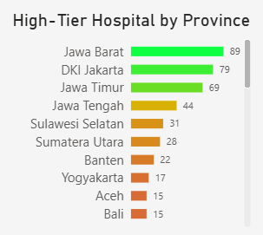
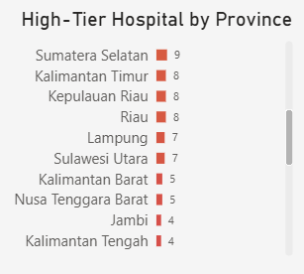
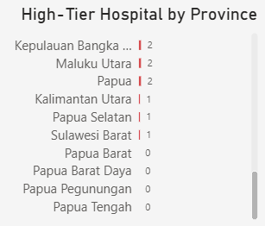
High-Tier Hospital Distribution
Data Evaluation
In this analysis, high-tier hospitals refer to the combined number of Class A and Class B hospitals, which provide advanced medical services and specialized healthcare. The distribution of these hospitals is highly concentrated in a few provinces, particularly West Java, DKI Jakarta, and East Java. In contrast, many provinces have only a limited number of high-tier hospitals, while Papua Barat, Papua Barat Daya, Papua Pegunungan, and Papua Tengah have none.

Slide 15
Key Findings
Conclusion
Healthcare infrastructure is available across all Indonesian provinces, with a total of 3,155 hospitals, 394,985 hospital beds, and 826,549 healthcare workers.
Hospital beds per 1,000 population indicate that many provinces have established a reasonable level of inpatient healthcare capacity, suggesting that basic healthcare infrastructure is relatively widespread.
However, the distribution of Class A and Class B hospitals remains highly concentrated, particularly in Java, while several provinces have few or no high-tier hospitals.
Recommendations
Although Indonesia has successfully expanded its basic healthcare infrastructure, equitable access to advanced healthcare services has not yet been achieved. The unequal distribution of high-tier hospitals suggests that patients in several provinces may face limited access to specialized services and rely on referrals to other regions. Therefore, future healthcare planning should focus not only on increasing infrastructure but also on improving the equitable distribution of high-tier healthcare services.

Slide 16

All files associated with this report can be accessed using the link below.
Kaggle Dataset
BPS Dataset
GitHub Files

